Slide 1

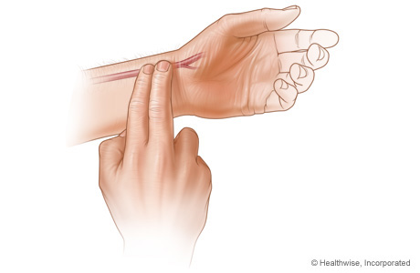
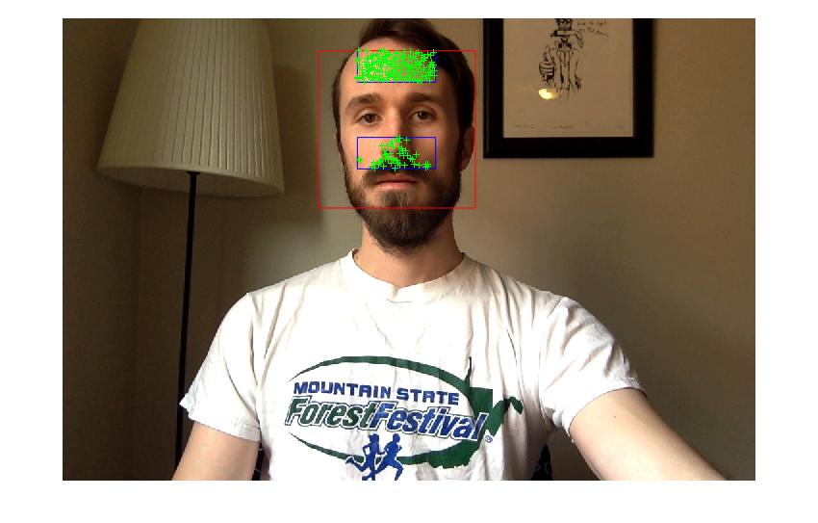
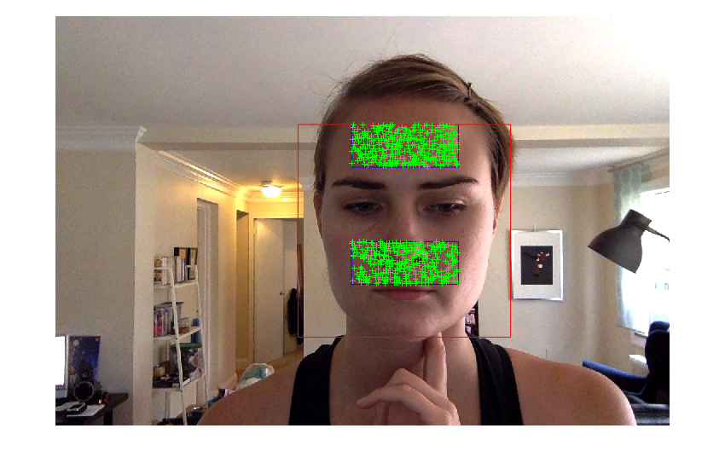
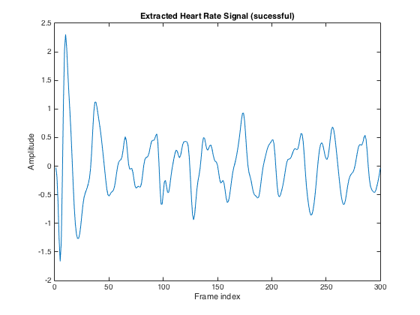
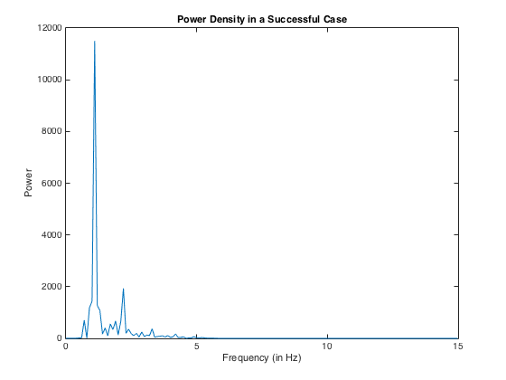
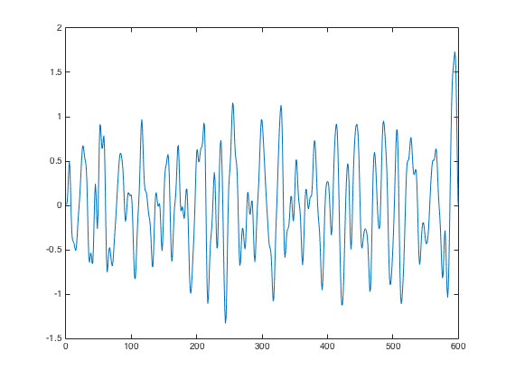
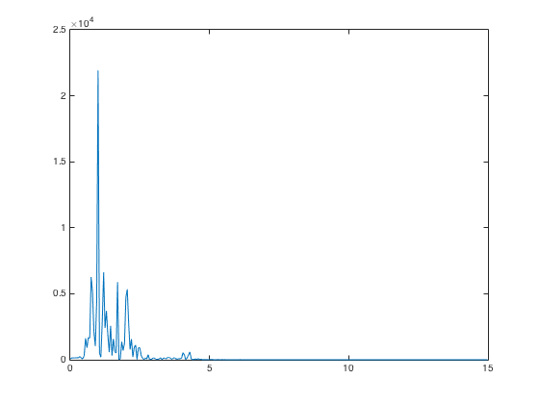
Contactless Heart Rate Monitoring of Individuals After Exercise Jennifer Lake
BACKGROUND INFORMATION ON EXERCISE
In 2008, only 48% of Americans met the minimum physical activity guidelines
Minimum Recommended Exercise Per Week (American Heart Association)
Choose 1 or a combination:
75 minutes vigorous exercise
150 minutes moderate exercise
Muscle-strengthening activities twice a week
Determining Exercise Intensity
Maximum Heart Rate = 220 – Age
Moderate exercise – 50-70% of Maximum Heart Rate
Vigorous exercise – 70-85% of Maximum Heart Rate
How to Determine Pulse Manually
Cartoid (neck) or Radial (wrist) artery is located with two fingers and pulse is counted for 15 seconds and then multiplied by 4
PREVIOUS WORK
Eulerian Motion Magnification for Revealing Subtle Changes in the World (2012)
This method was used in the Phillips Vital Signs Camera app
Detecting Pulse from Head Motions in Video (2013)
This method was implemented in this project
DIFFERENCES BETWEEN PREVIOUS WORK AND THIS PROJECT
Image quality
This project: Macbook Pro Eyesight (1080 × 720 pixels, 30 fps)
Previous work: Panasonic Lumix GF2 (1280 x 72, 30 fps)
Face size within image
This project: appromixately 220 x 340 pixels
Previous work: 570 x 718 pixels
Video length
This project: 25 seconds
Previous work: 70 -90 second
Heart rate range
This project: 45 – 170 bpm
Previous work: 45 – 120 bpm
Subject’s activity level
This project: resting, after moderate or vigorous exercise
Previous work: resting
METHOD
* Indicates change from previous work
Capture 25 – 30 seconds of subject while taking pulse *
Calculate heart rate using Phillips Vital Signs Camera app * (for comparison)
Import the video
Skip the first second of the video to allow for vibration from button press to dissipate and for the camera to stabilize *
Using the Viola-Jones face detection algorithm, find the biggest face present (there should only be one face in the image)
Find the top bounding box by taking the middle 50% of the face horizontally and the top 18% of the face vertically *
Find the bottom bounding box by taking the middle 50% of the face and 49.5% - 72% of the face vertically
Find Shi-Tomasi feature points within the bounding boxes
Track features over the next 20 seconds of frames using Lucas-Kanade Tracking
Calculate the L2 distance of each trace and remove those that exceed the mode (round to integers)
Apply a 5th order Butterworth filter to each trace, only allowing frequencies between .45 Hz and 5 Hz
Calculate the covariance matrix and find its eigenvectors
Using only the first 5 eigenvectors, multiply each eigenvector by the traces to form s₁, s₂, s₃, s₄, and s₅
Transform all s_{i} using Fast Fourier Transform (fft) and calculate the power density by taking the absolute value of the fft and squaring it
Calculate the periodicity of each s_{i} by finding the maximum power frequency (f_{max}) and dividing the sum of the maximum power frequency and its first harmonic by the sum of all points in the power density
Choose the s_{i} with the greatest periodicity and calculate pulse = 60f_{max}*
RESULTS
Figure 1: Examples of feature points found and bounding boxes used
Figure 2 – Signal and Power Density in a successful case
Figure 3 – Signal and Power Density in an unsuccessful case
Subject | Manual Heart Rate | Motion (this project) | Error (Motion) | Color (Phillips Vital Signs) | Error (Color) | Heart Rate Zone
1 | 68 | 65.90 | 2.10 | 63 | 5 | Resting
1 | 120 | 59.92 | 60.08 | 120 | 0 | Moderate
1 | 132 | 56.93 | 75.07 | 134 | 2 | Vigorous
1 | 100 | 59.97 | 40.03 | 98 | 2 | Moderate
2 | 70 | 68.96 | 1.04 | -- | -- | Resting
2 | 68 | 68.91 | 0.91 | 71 | 3 | Resting
2 | 71 | 50.83 | 20.17 | 63 | 8 | Resting (after exercise)
2 | 93 | 56.81 | 36.19 | 98 | 0 | Moderate
2 | 116 | 53.87 | 62.13 | 111 | 5 | Moderate
Figure 4- Results from this project (all heart rates are in beats per minute)

